Slide 1



Chest X-ray Abnormalities Detection

Slide 2
Kulkarni Ganesh Shivajirao
ED16B016
InuAid Solutions Pvt.Ltd
Guide : Ganapathy Krishnamurthi

Slide 3
Findings
Imbalance dataset resulting model to train for some categories only
Single trained model not able to improve score
Validation dataset is not helping for training
Used partial classes dataset, score improved to 0.192

Slide 4
K Folds
Used K folds method
Split image dataset into 5 folds, each with 3000 images
Trained five yolov5 models
In each training, used 4 folds for train and 1 fold for val
Generated results using each trained model
Used WBF Ensemble method to merge results

Slide 5
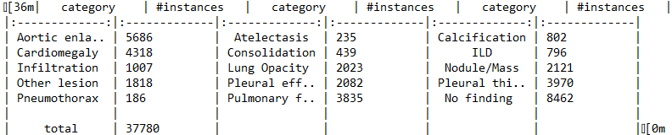
Dataset
15000 total DICOM Images
14 classes with Bbox
Number of instances are given here:

Slide 6
Dataset
Instances are given below:
Folds | Train Instances |  | Validation Instances
 | Found | Empty | Found | Empty
Model 0 | 26697 | 8485 | 6628 | 2121
Model 1 | 26561 | 8482 | 6764 | 2124
Model 2 | 26563 | 8485 | 6762 | 2121
Model 3 | 26845 | 8479 | 6480 | 2127
Model 4 | 26634 | 8493 | 6691 | 2113

Slide 7
YoloV5 Model
Images : Train 12000 and Val 3000
Batch Size 40
Image Size 640
Optimizer SGD
False Images included
No. of Classes 14 (no finding excluded)

Slide 8
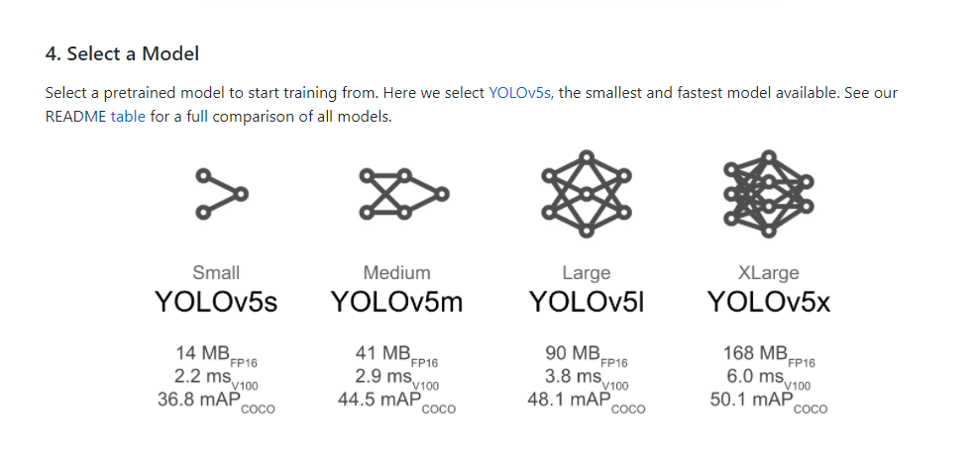
YoloV5 Model
Kept Default hyperparameters
Used pretrained yolov5x model

Slide 9
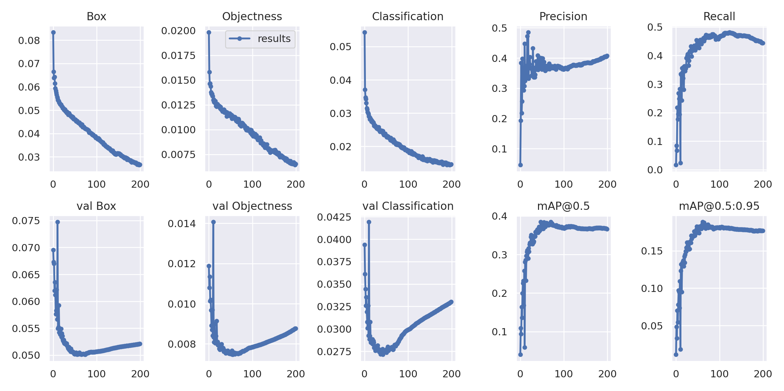
Model_0 Results

Slide 10
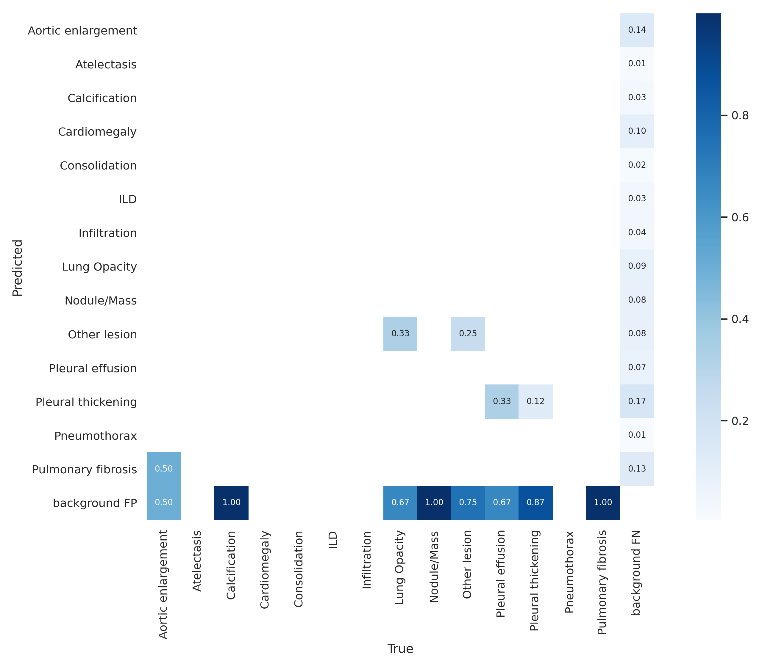
Fold_0 Results

Slide 11
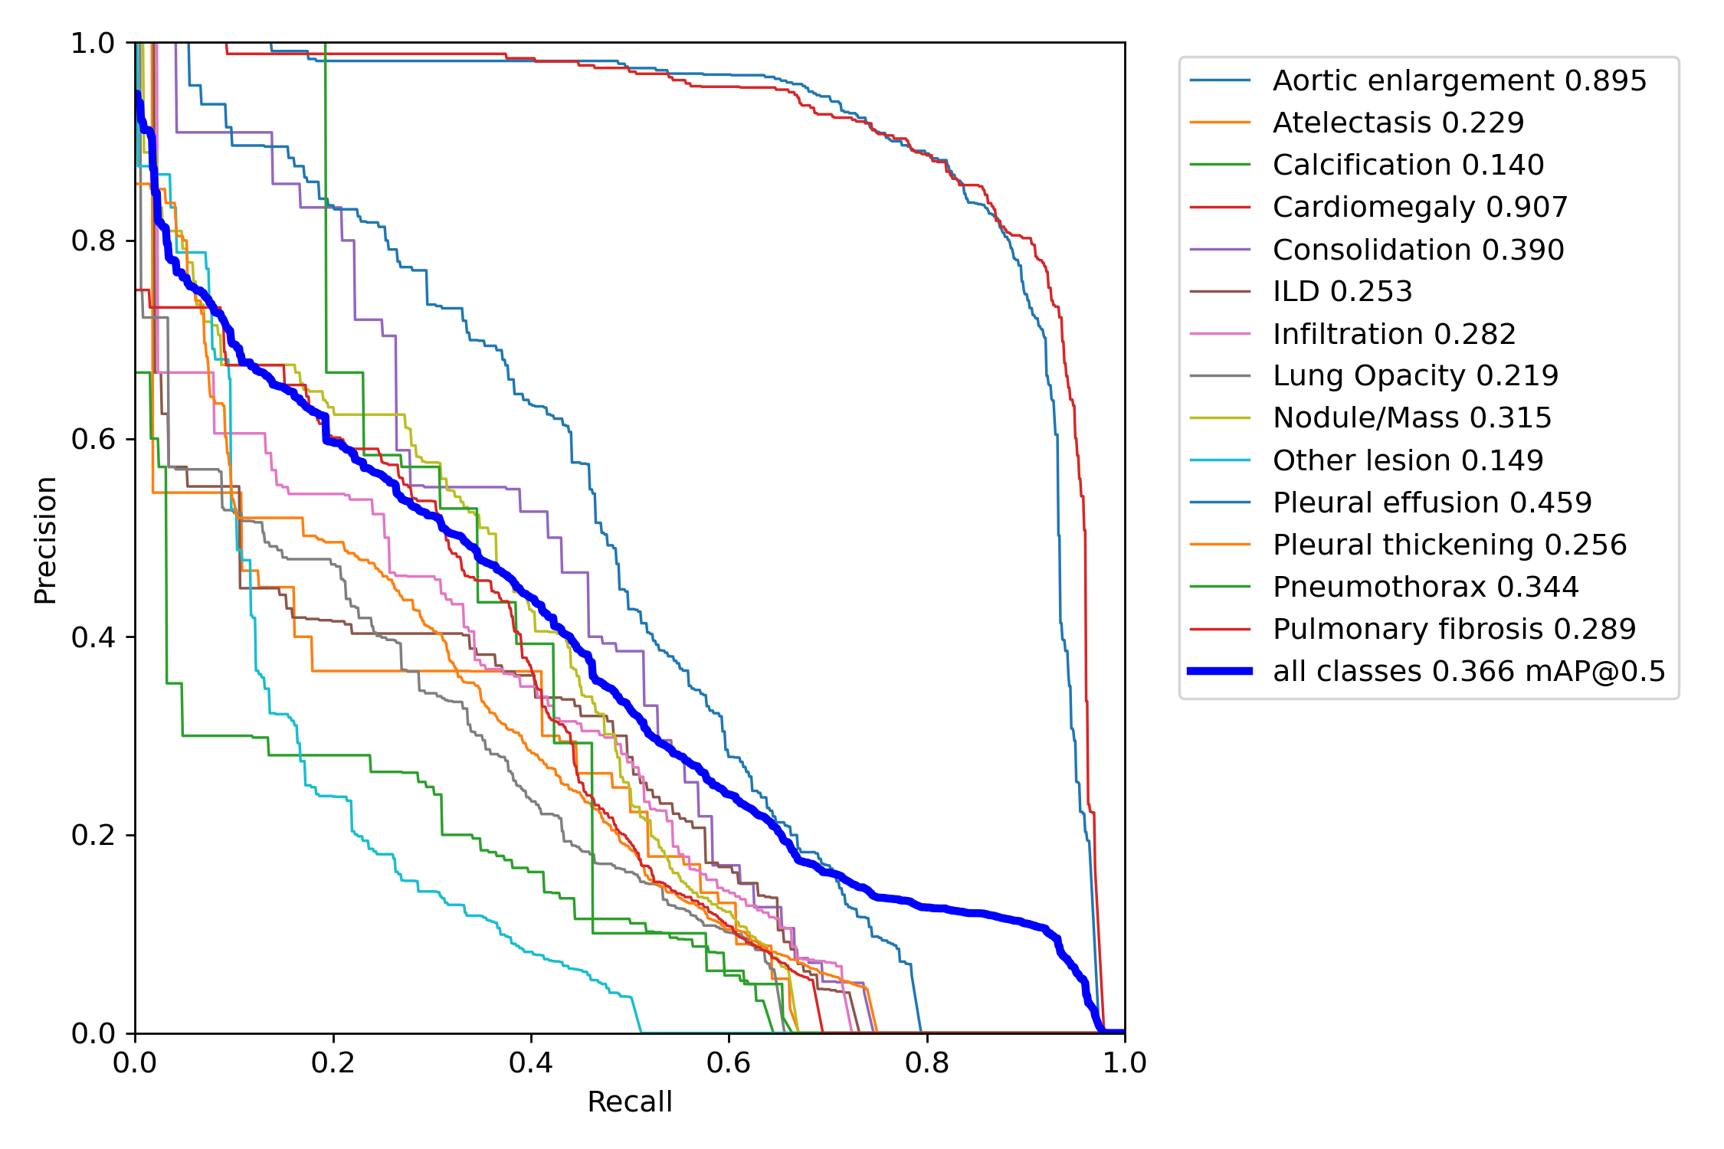
Fold_0 Results

Slide 12
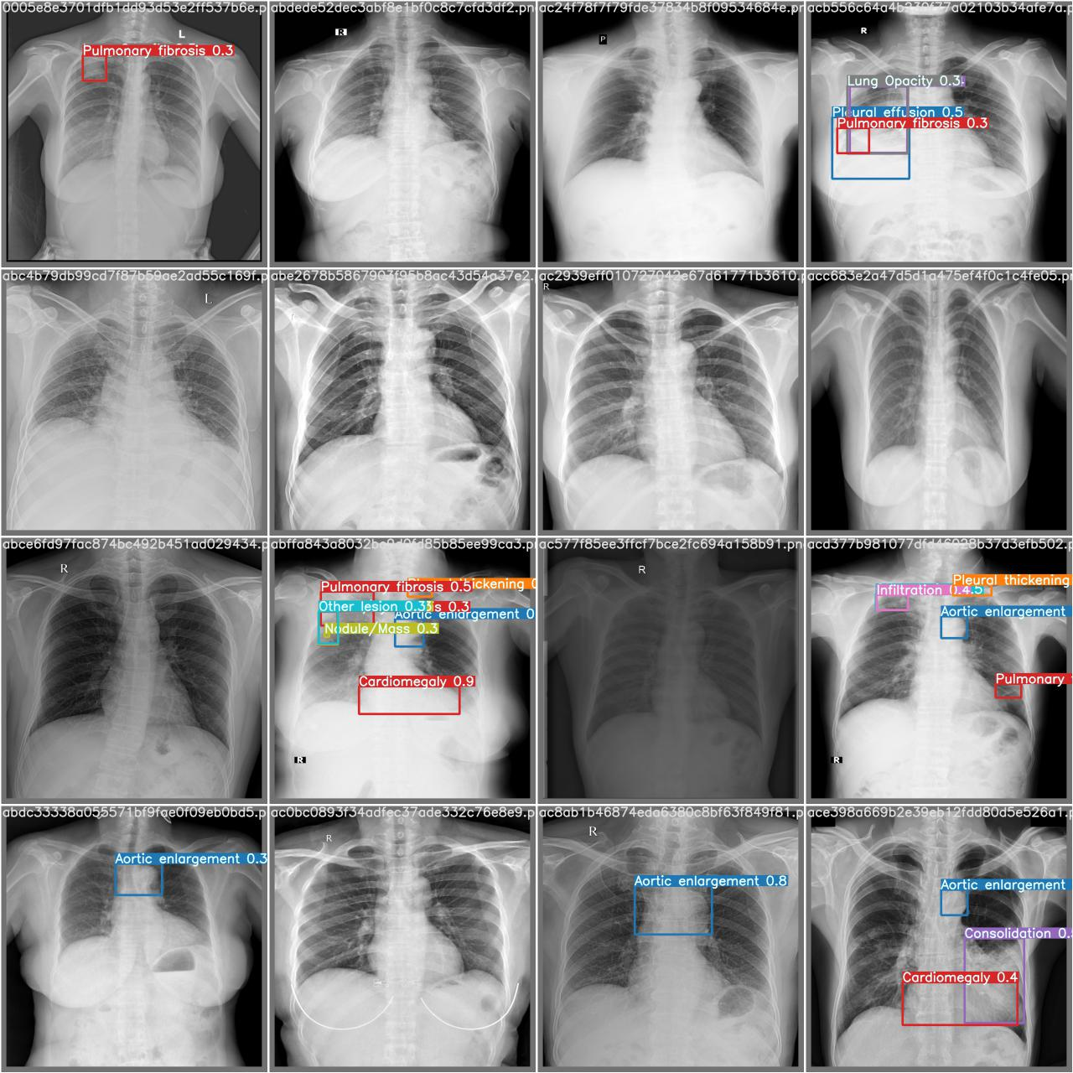
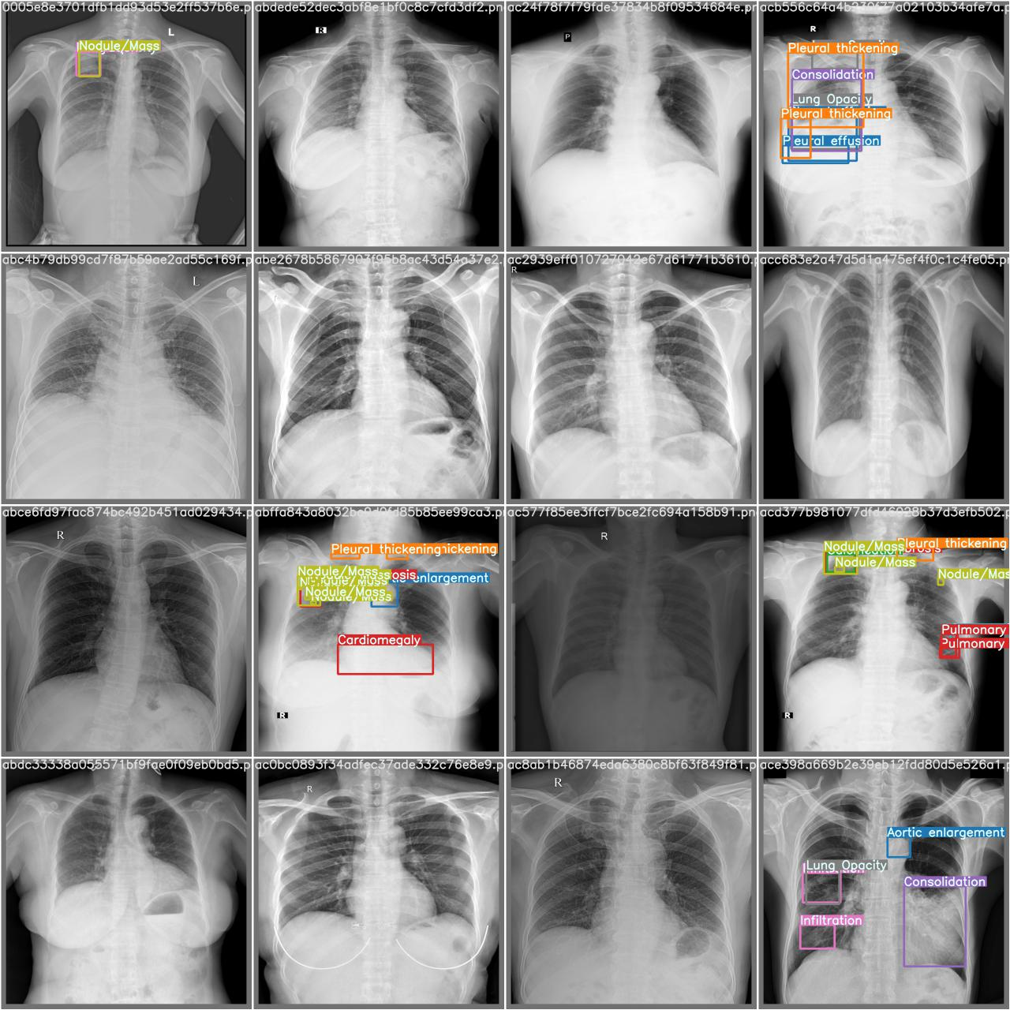
Fold_0 Results
Prediction True

Slide 13
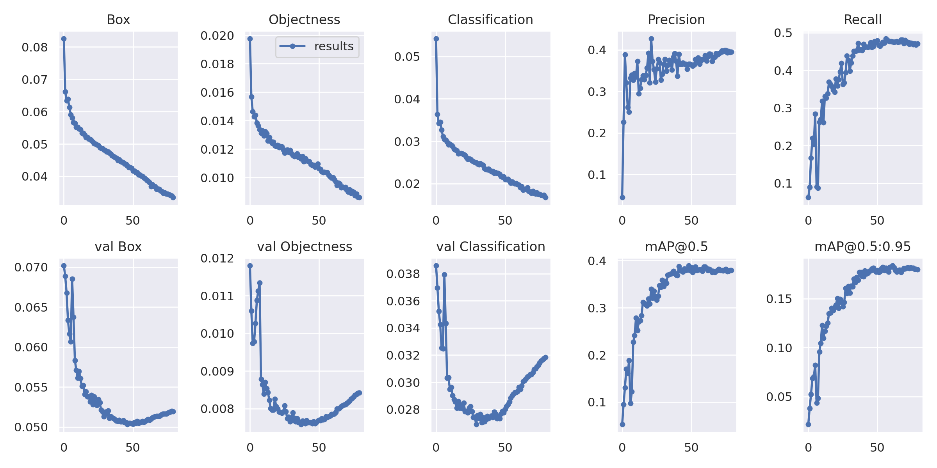
Model_1 Results

Slide 14
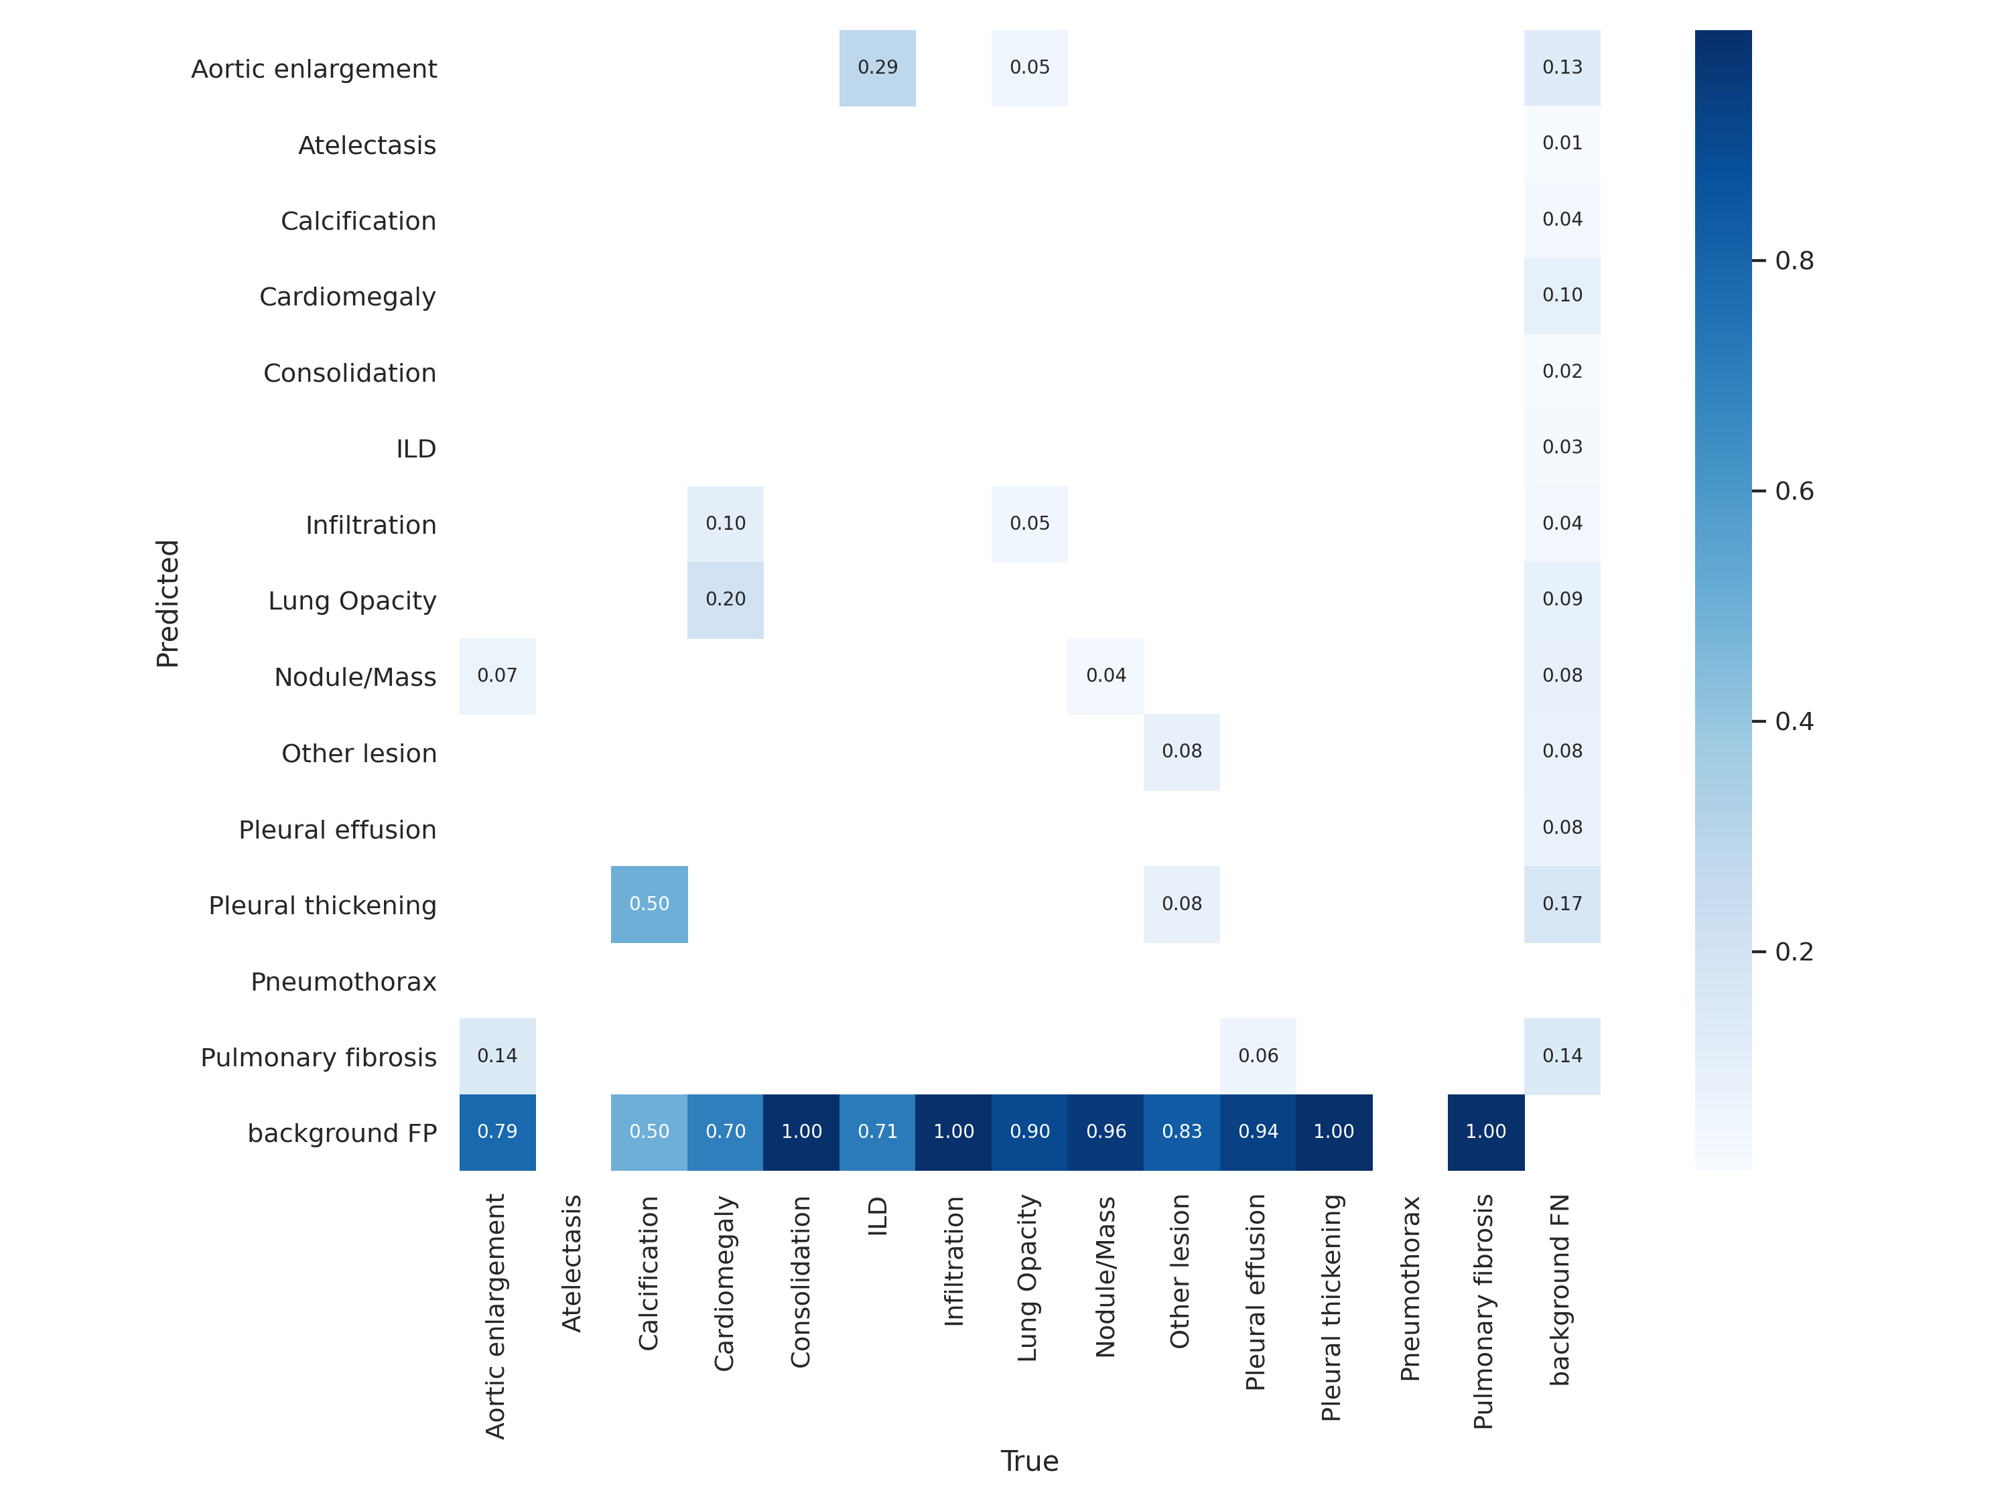
Fold_1 Results

Slide 15
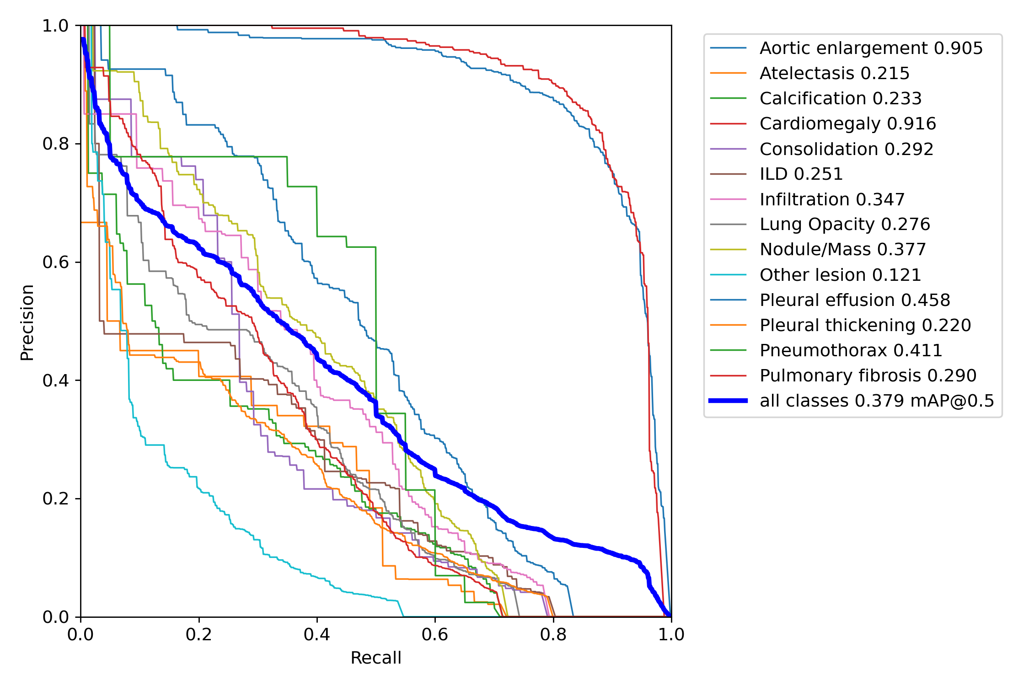
Fold_1 Results

Slide 16
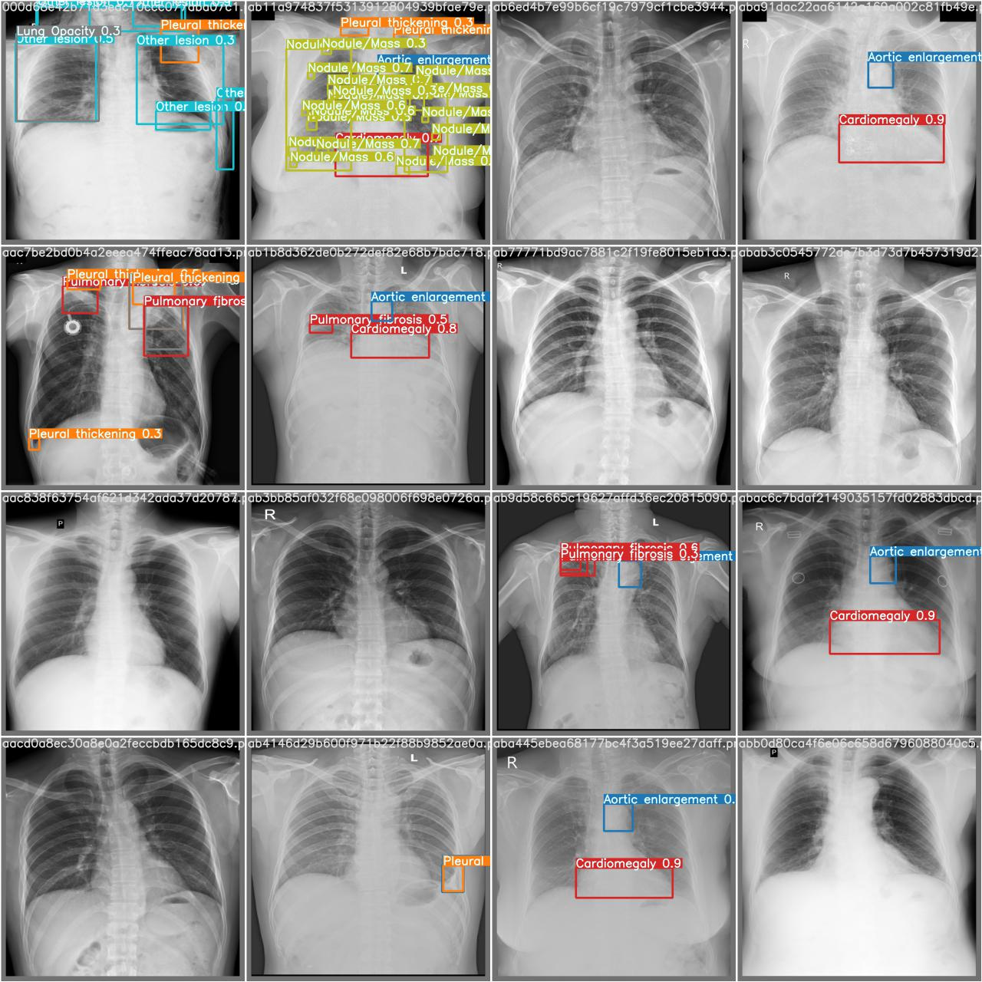
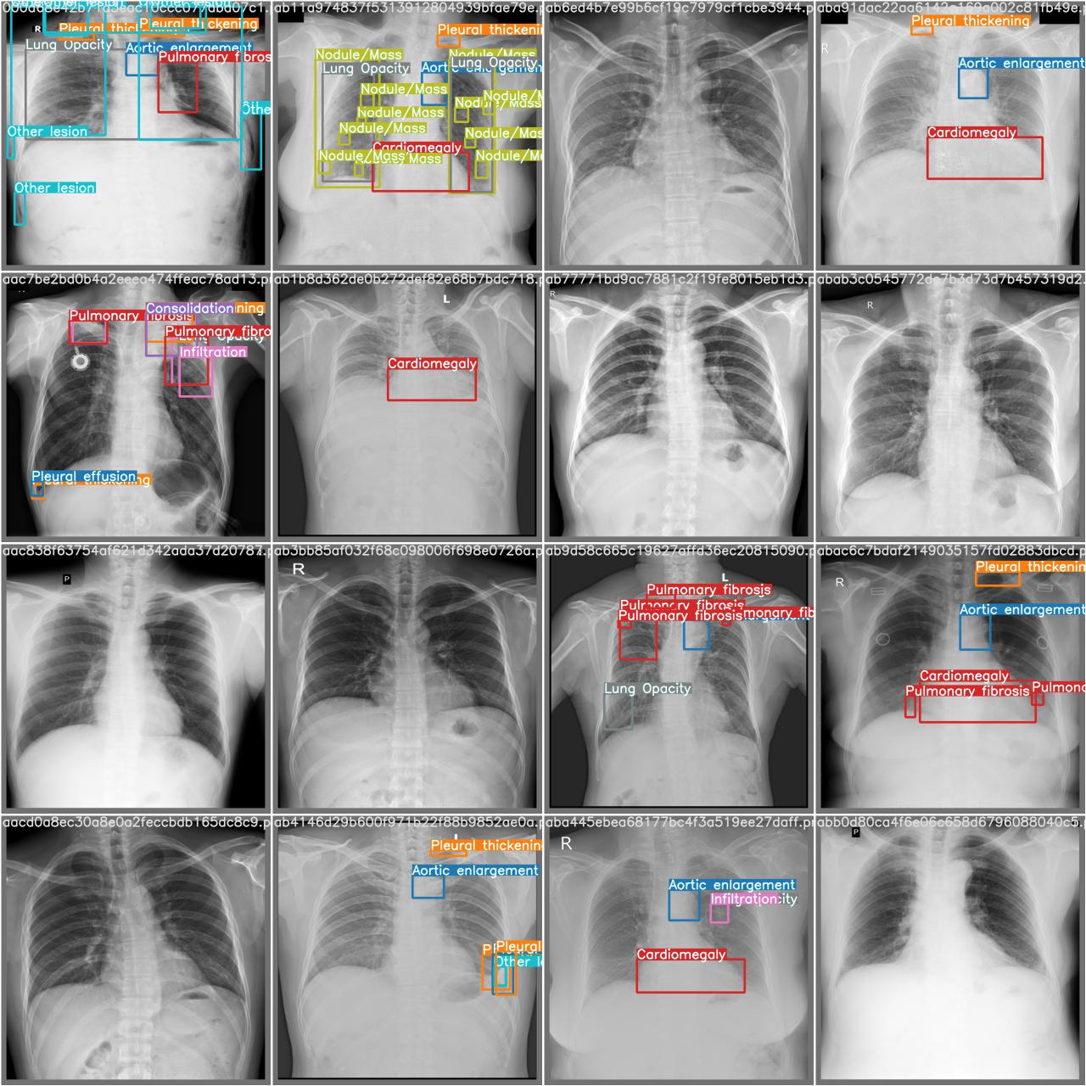
Fold_1 Results
Prediction True

Slide 17
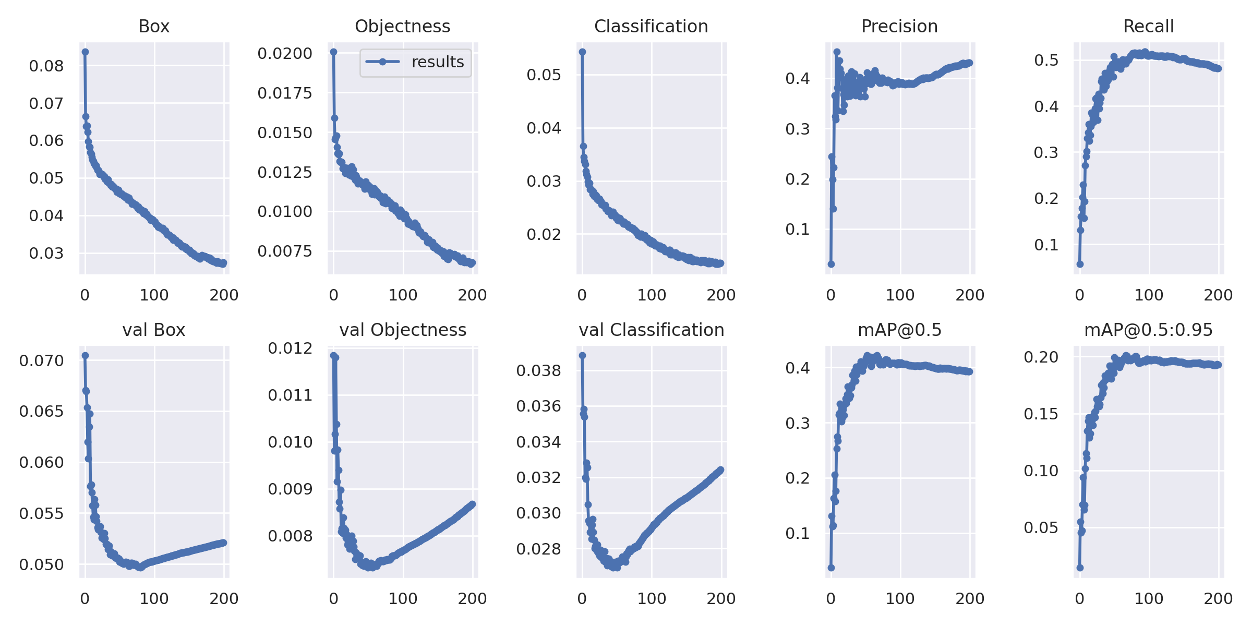
Model_2 Results

Slide 18
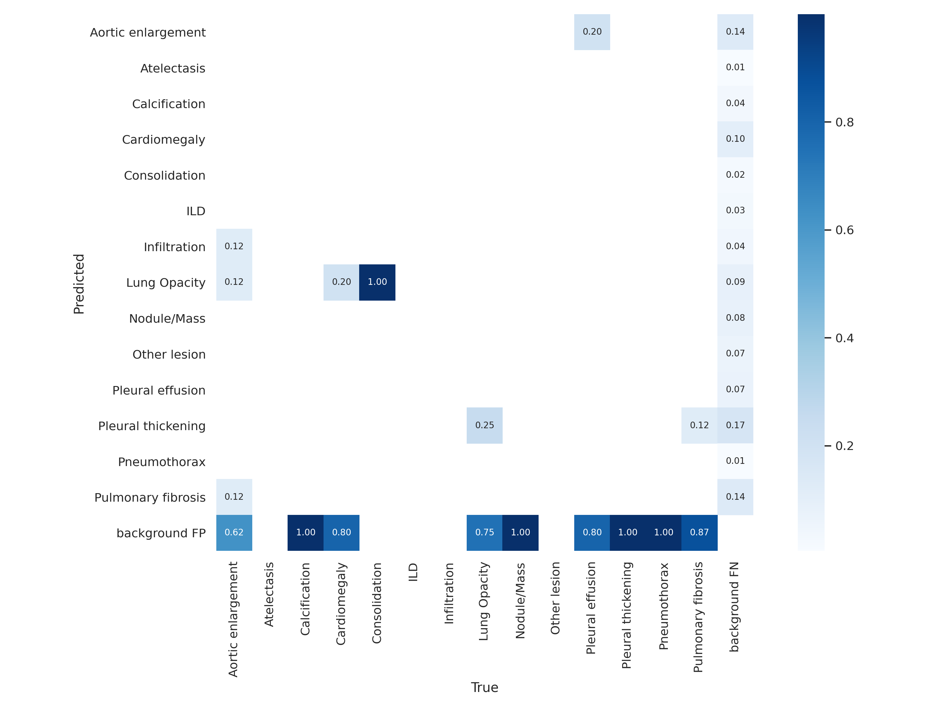
Fold_2 Results

Slide 19
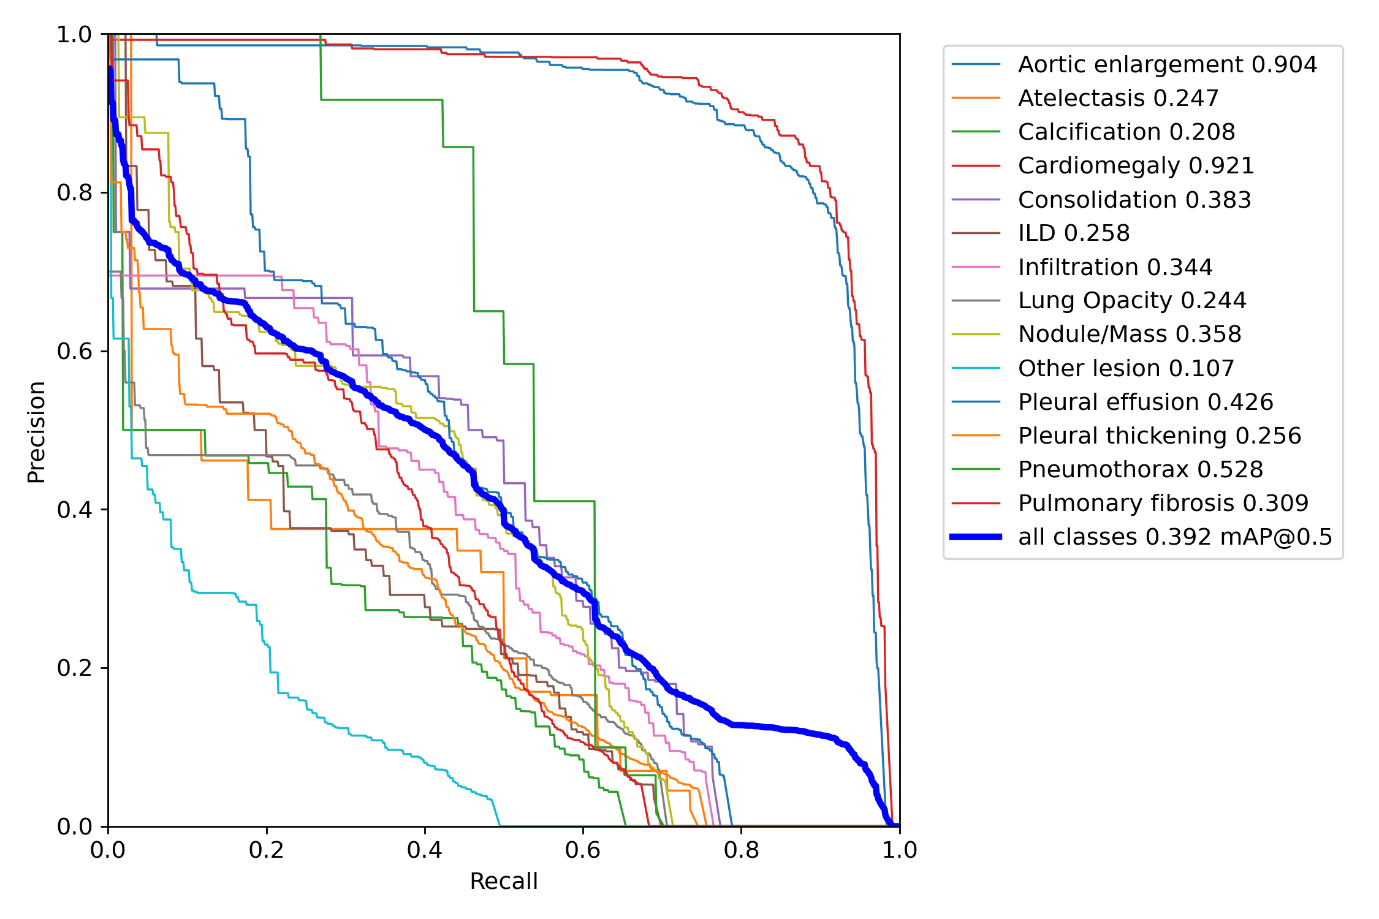
Fold_2 Results

Slide 20
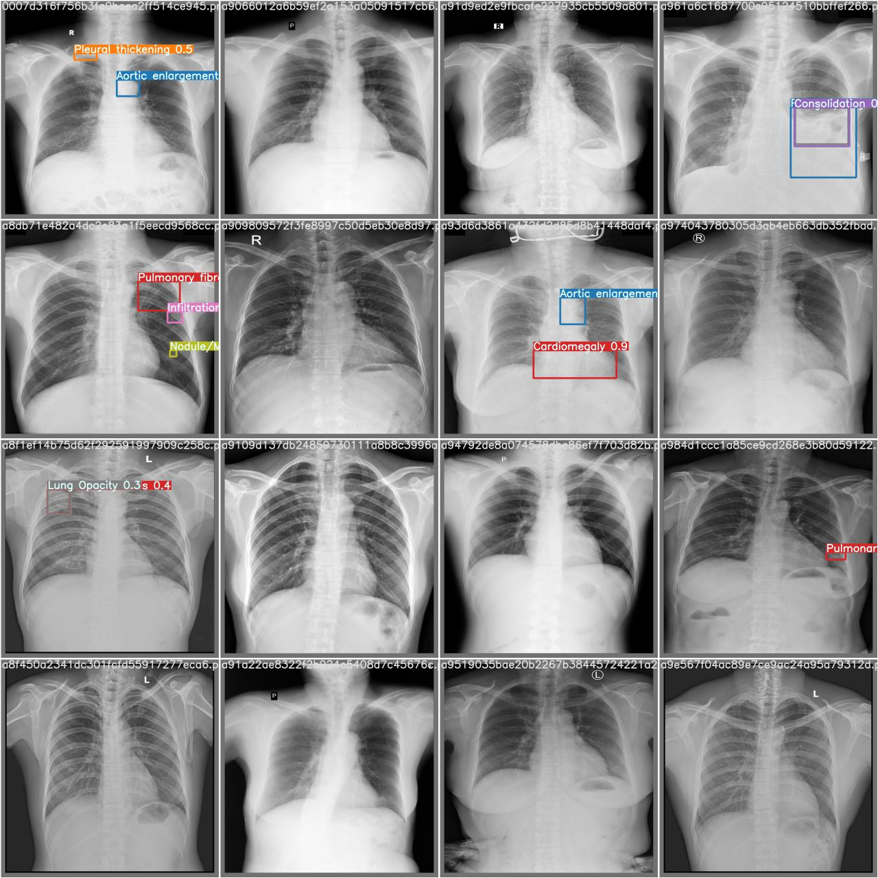
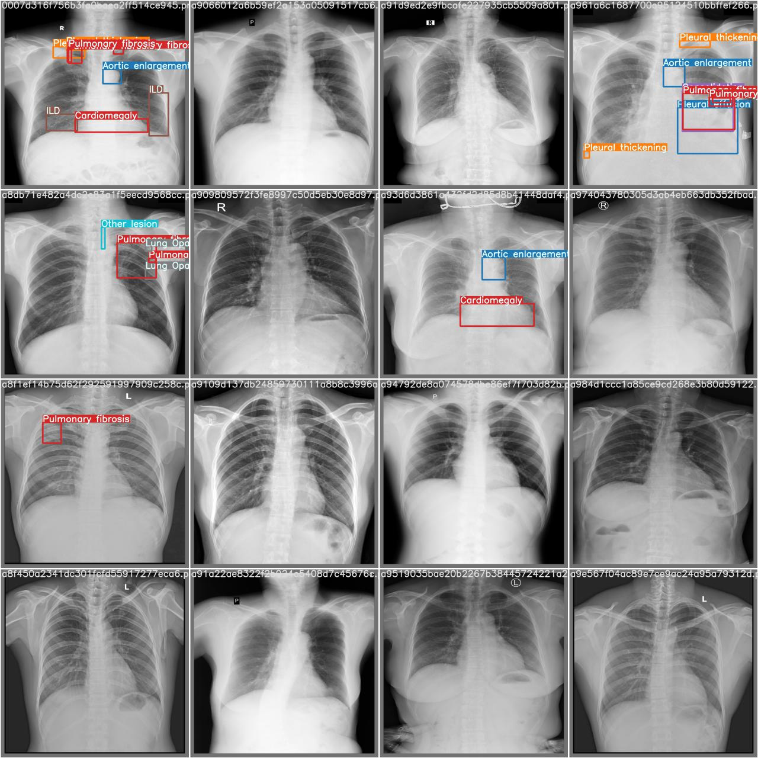
Fold_2 Results
Prediction True

Slide 21
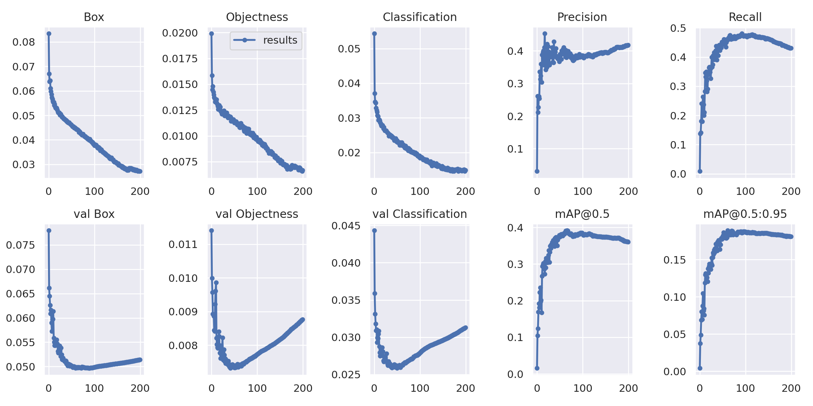
Fold_3 Results

Slide 22
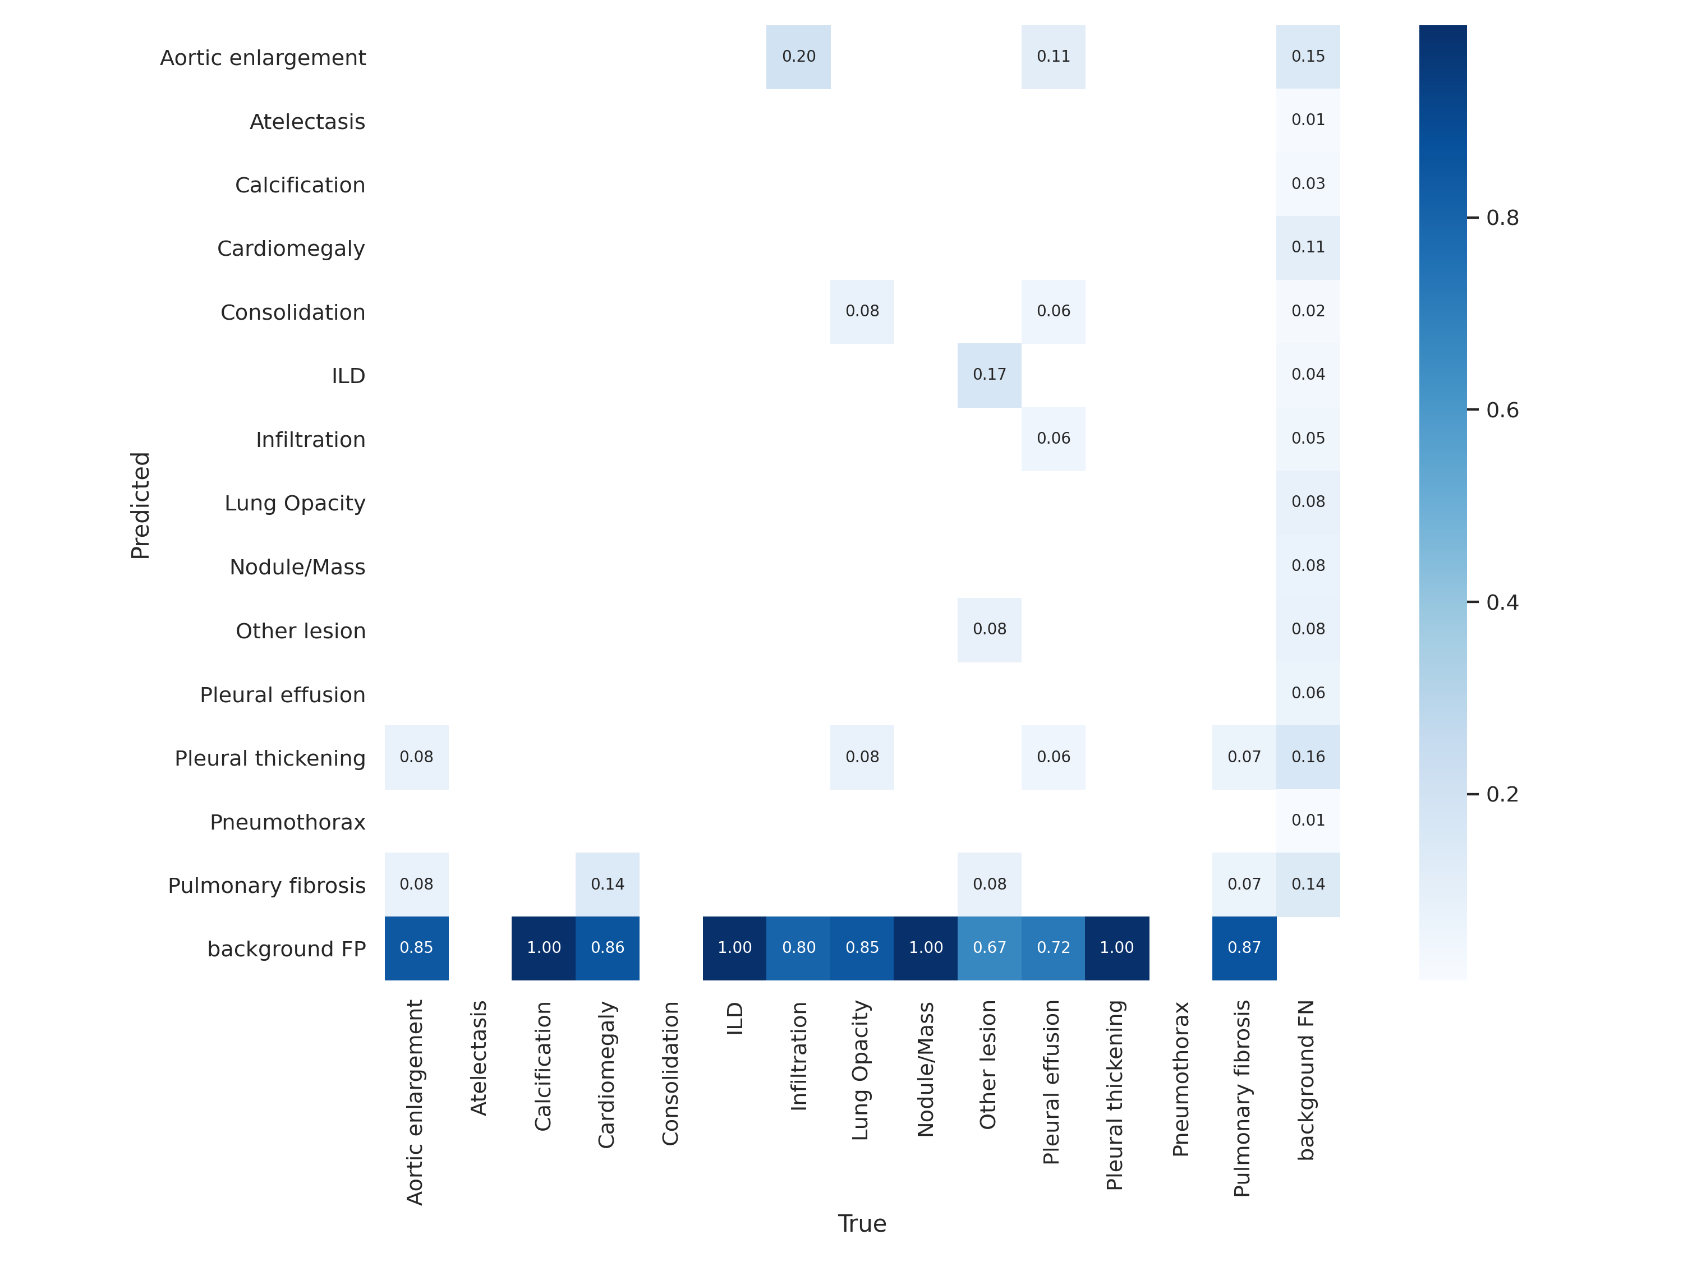
Fold_3 Results

Slide 23
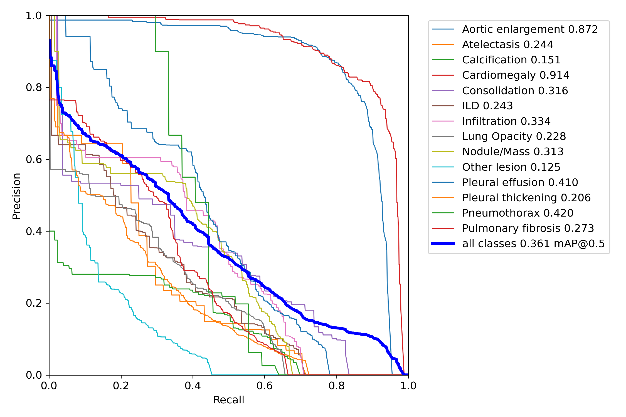
Fold_3 Results

Slide 24
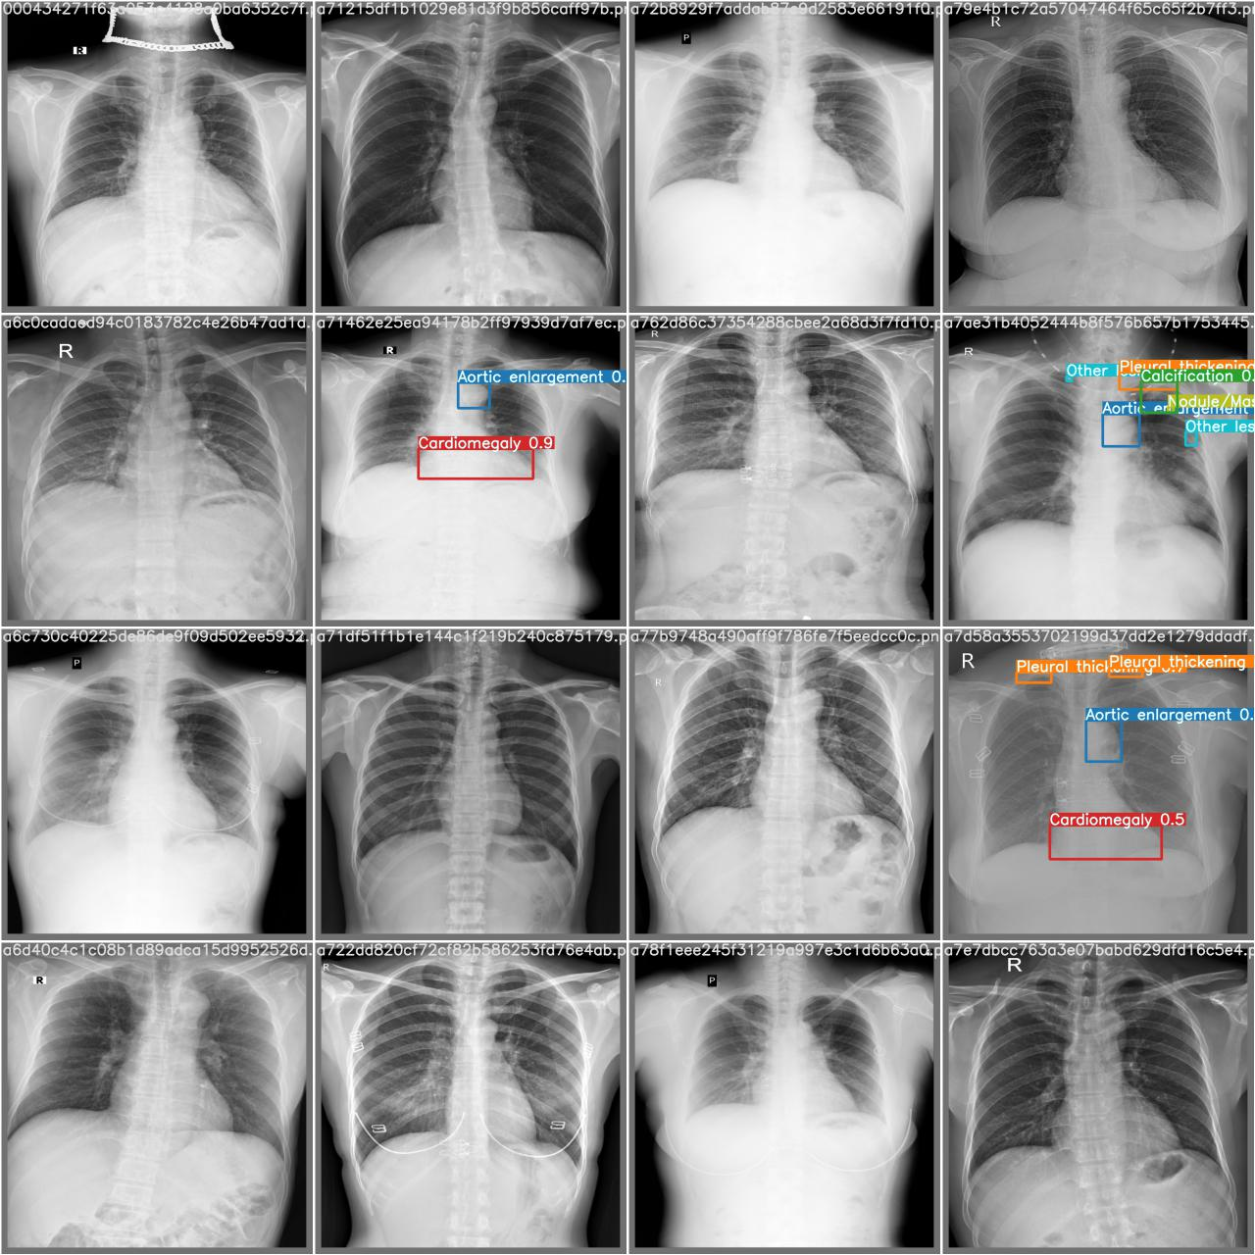
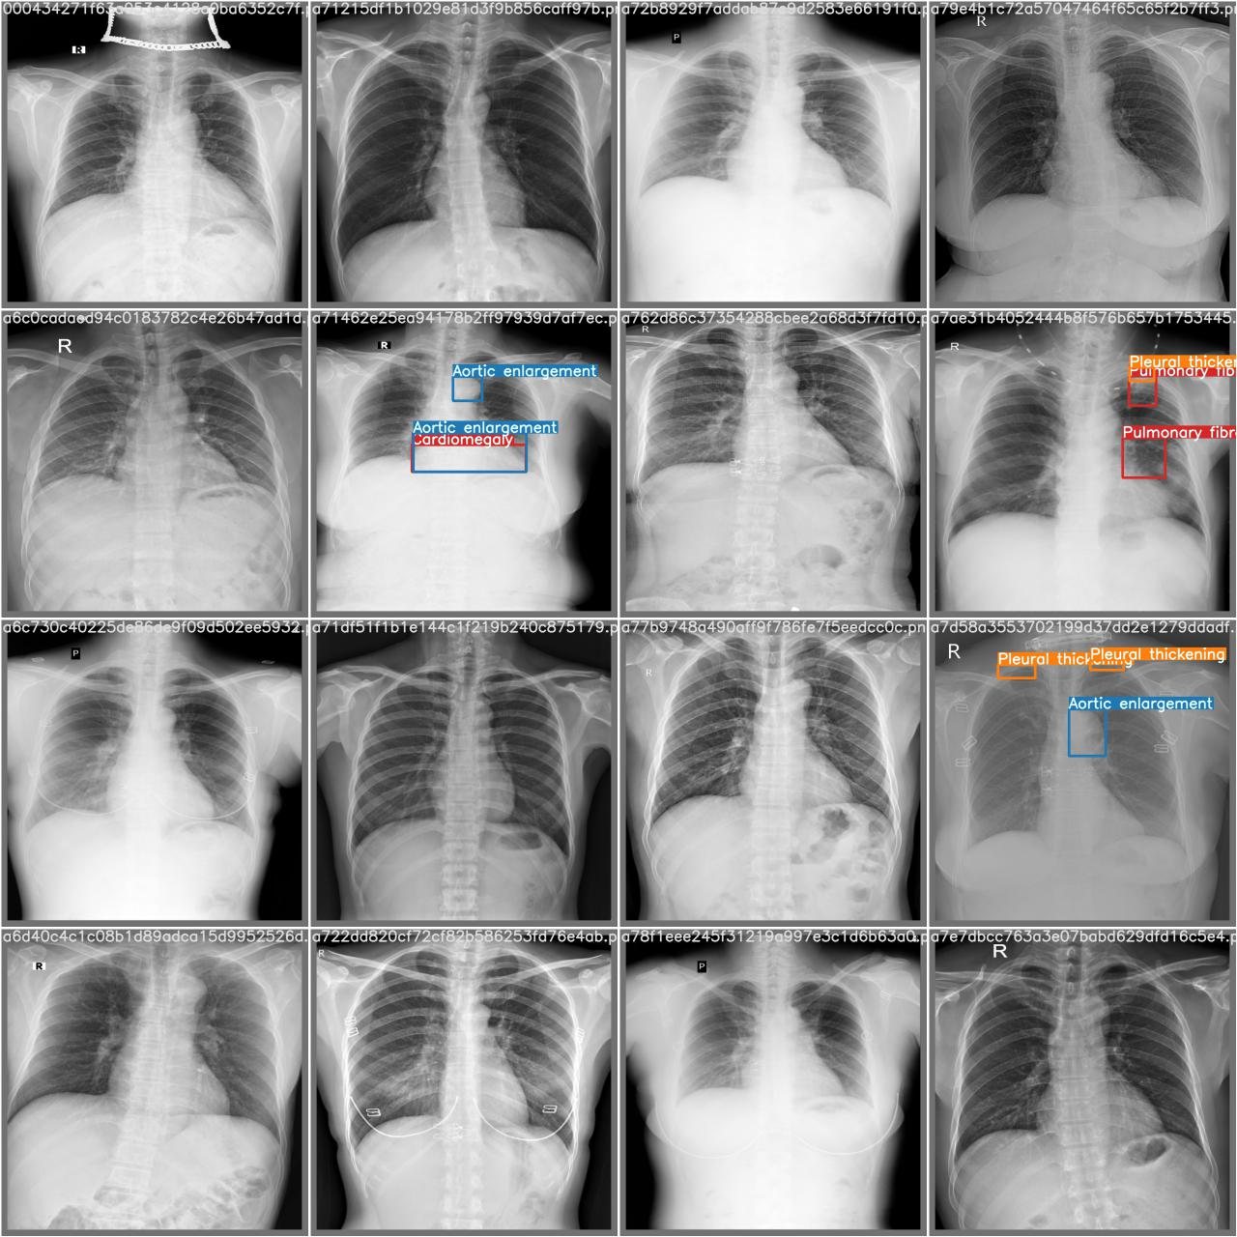
Fold_3 Results
Prediction True

Slide 25
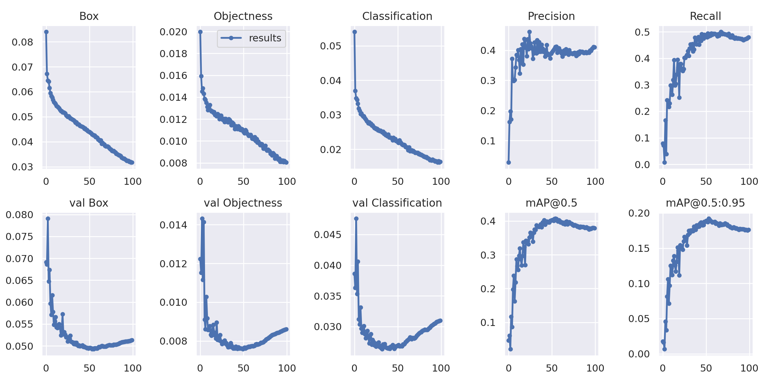
Fold_4 Results

Slide 26
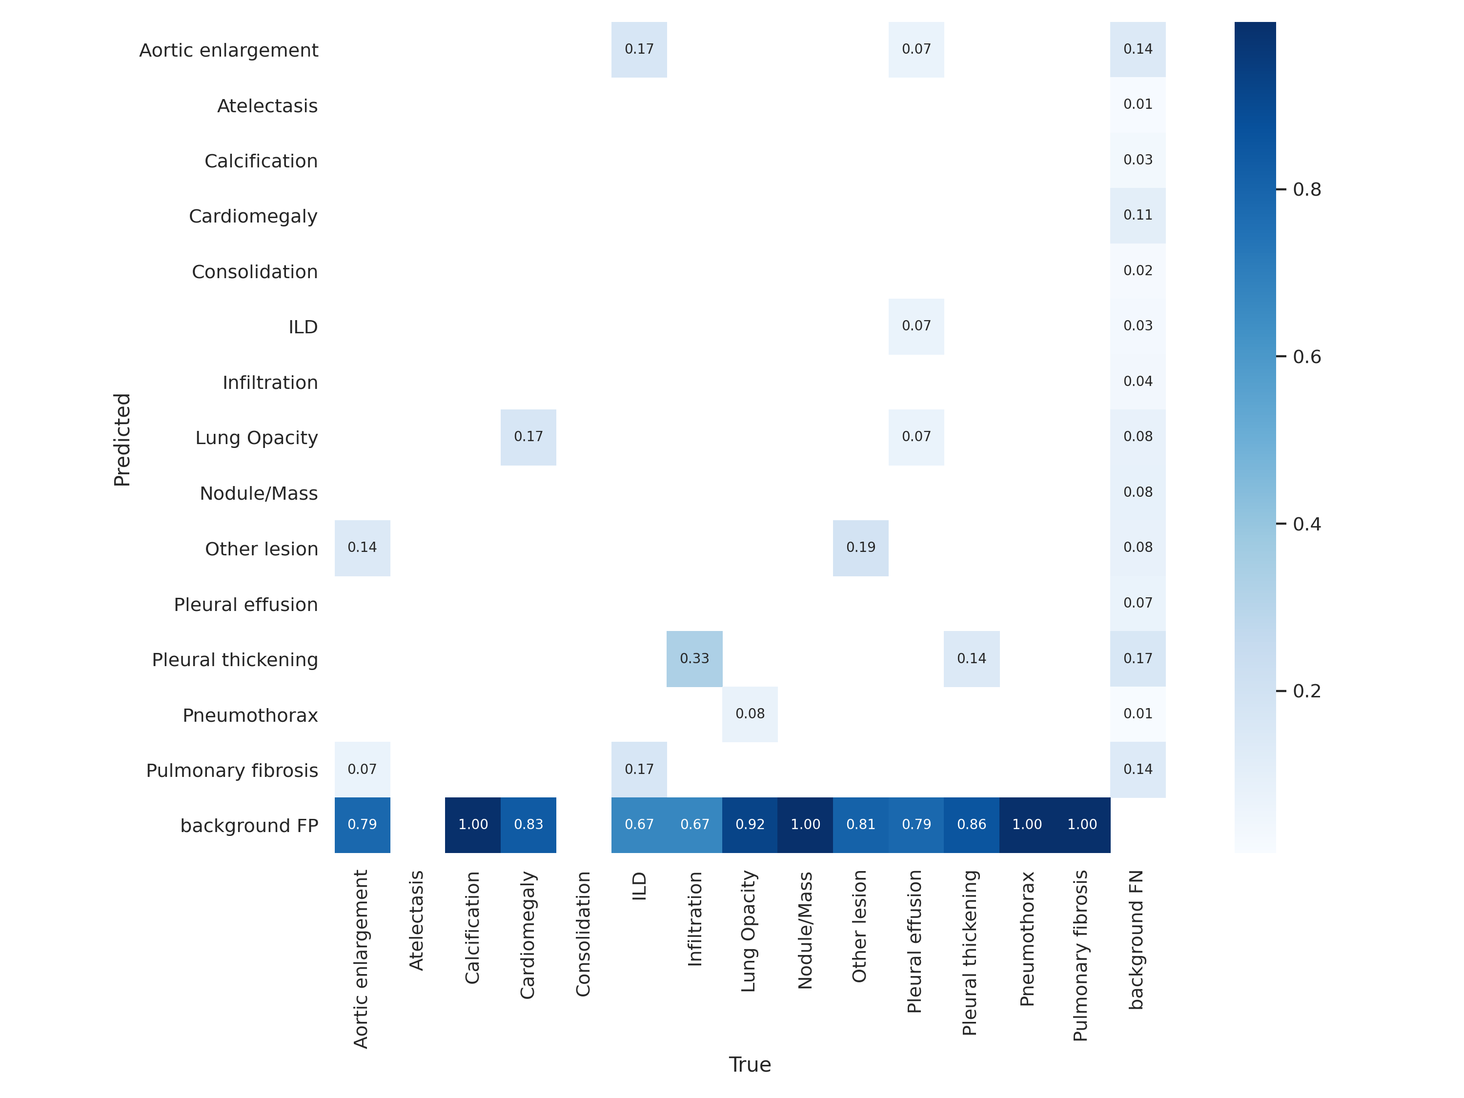
Fold_4 Results

Slide 27
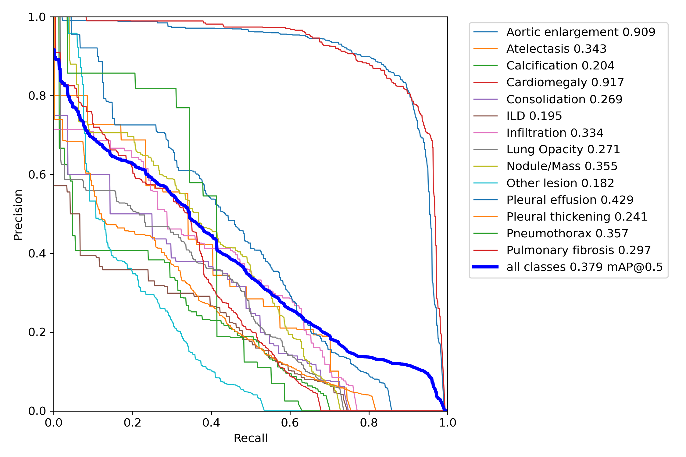
Fold_4 Results

Slide 28
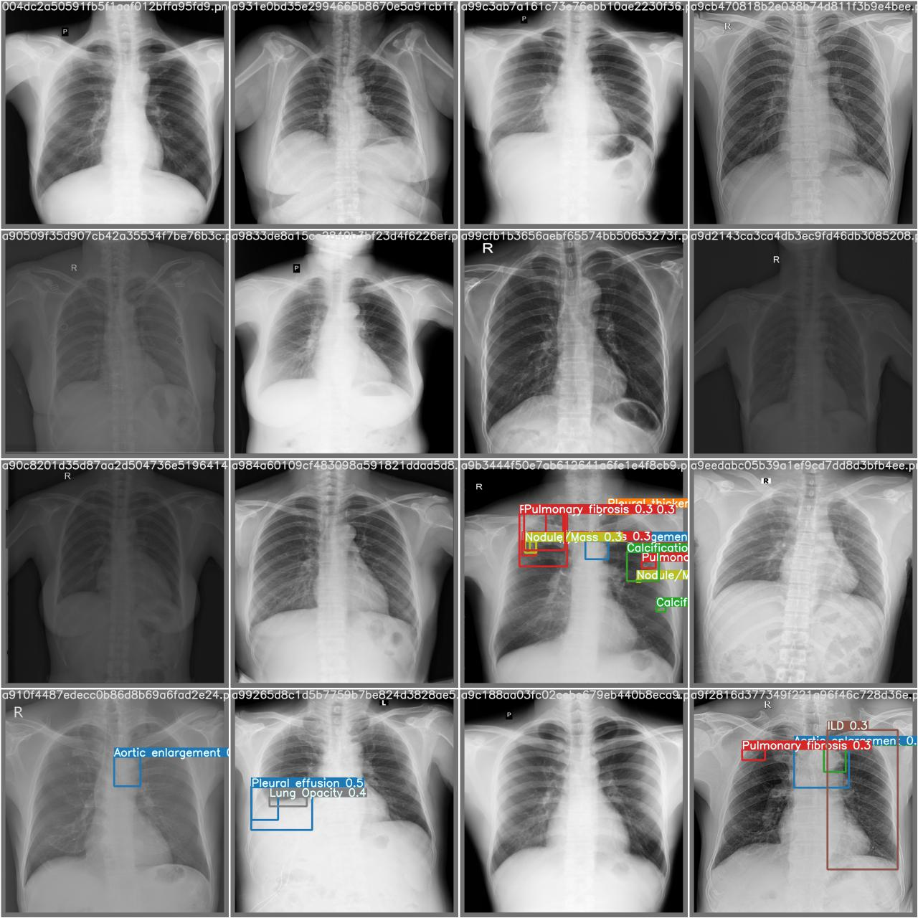
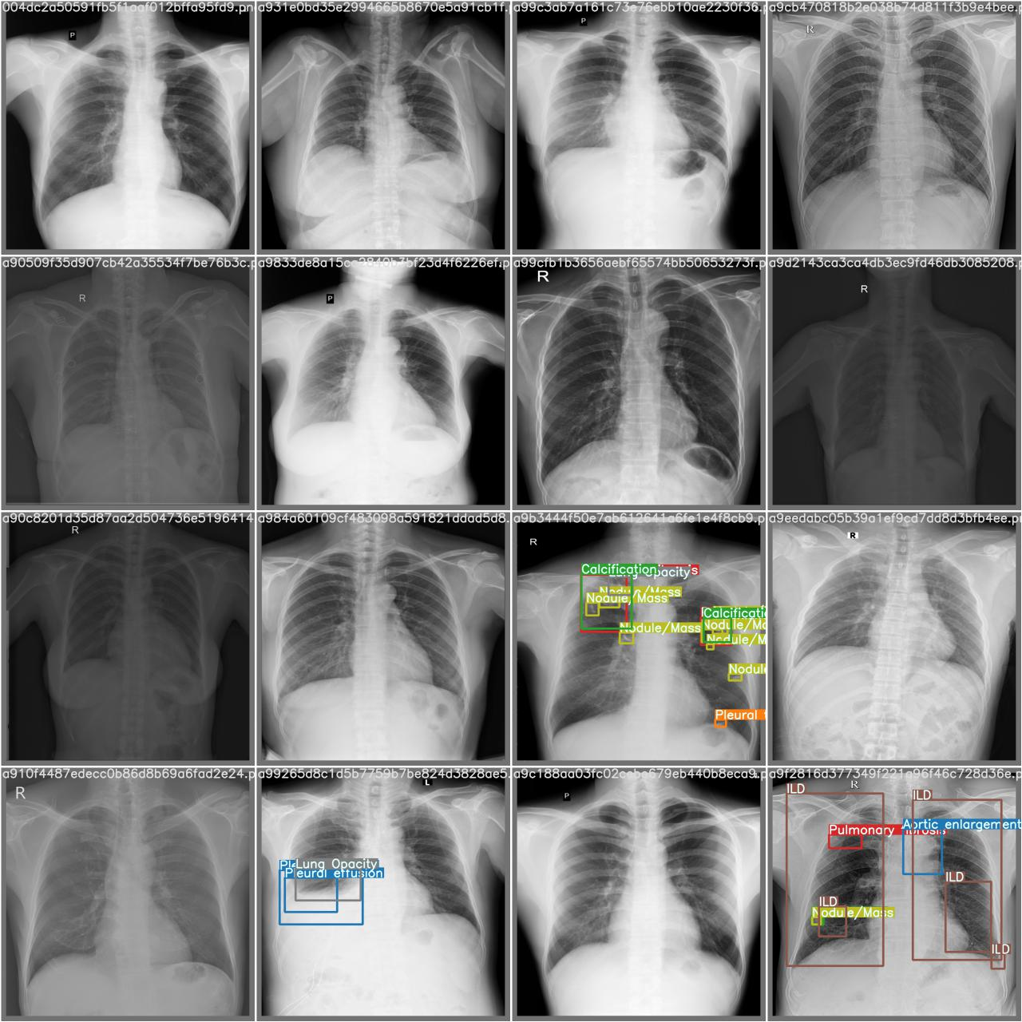
Fold_4 Results
Prediction True

Slide 29
Ensemble
Generated results on test dataset with each model:
Image Size : 640
Iou-thres: 0.25
Conf-thres: 0.01
Weight: best.pt (having best mAP on validation)
Use WBF to ensemble all generated results:
Iou_thres : 0.4
Skip_box_thres: 0.0001

Slide 30
Results
Test each model on Kaggle test data
Found score range of 0.13 to 0.16
Generated results with Ensemble method
Found public score : 0.243
Private score: 0.274

Slide 31
To Do
K Fold and ensemble method found to be effective
Tuning the hyperparameters
Working on class based fusing to improve the score
Ensemble another trained model to analyze scores
Working to improve the confusion metric for each model

Slide 32
Thank You

